Slide 1

CAMPUS RECRUITMENT QUANTITATIVE APTITUDE TRAINING
QUANT & REASONING DEPARTMENT

Slide 2
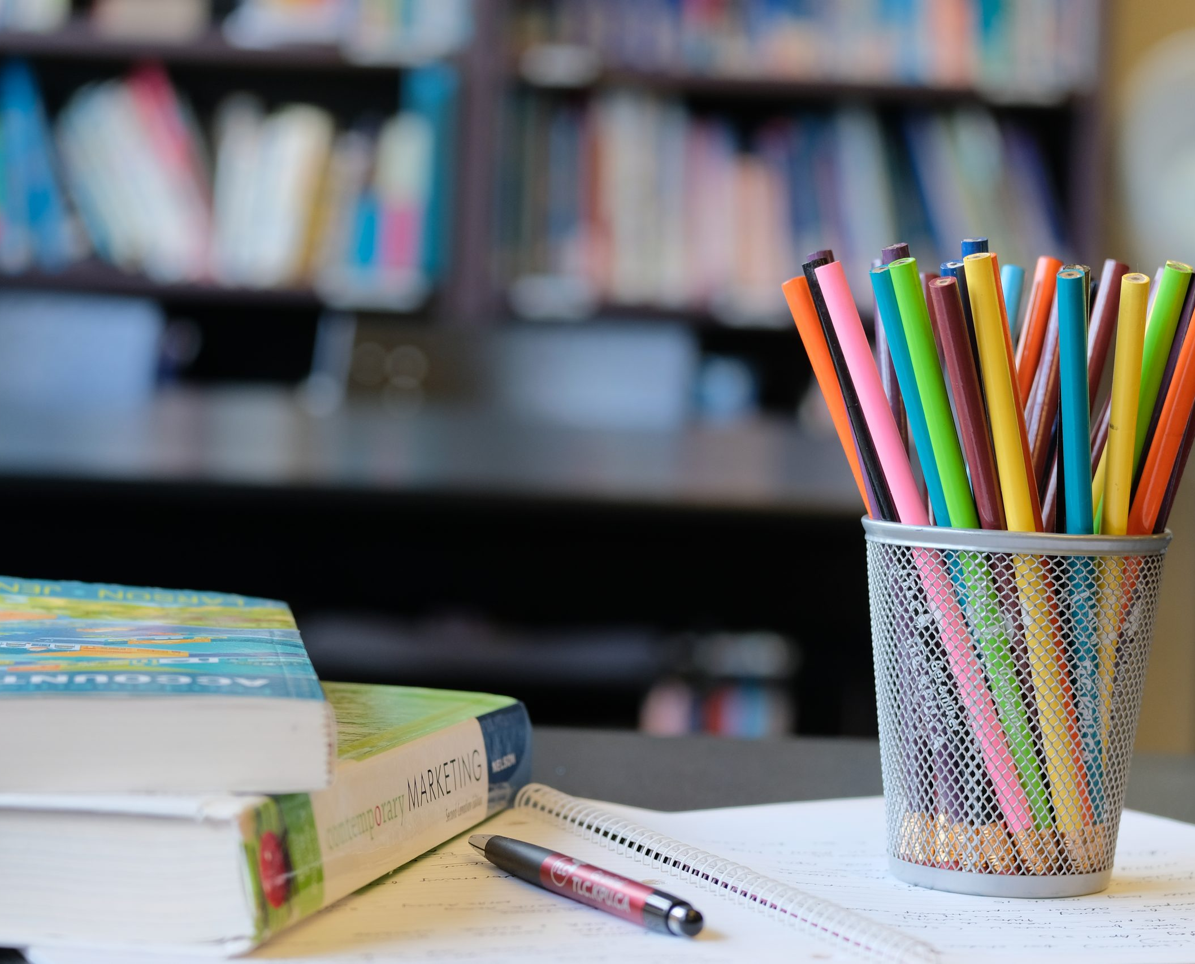
Welcome TO QUANTITATIVE APTITUDE & REASONING DEPARTMENT
university
QUANT &
REASONING

Slide 3
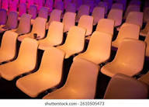
SEATING ARRANGEMENTS
QUANT & REASONING DEPARTMENT

Slide 4
SEATING ARRANGEMENTS
Data arrangement is one of the easiest topics in the Logical Reasoning section. Typically, a set of clues are given and one has to decipher them in order to arrange the given objects in a particular manner

Slide 5
SEATING ARRANGEMENTS
INDEX
Linear Arrangement
Circular Arrangement
Polygonal Arrangement

Slide 6


LINEAR ARRANGEMENT
LEFT
RIGHT
Facing north
RIGHT
LEFT
Facing south

Slide 7

SEATING ARRANGEMENTS
Answer the following questions based on LINEAR seating arrangement(from F to D)
1.Who is/are left of D?
2. Who is/are immediate left of D?
3. Who is/are right of F ?
4. Who is/are immediate right of F ?
5. Who is/are sitting BETWEEN F and D?
6.Who is/are sitting EXACTLY BETWEEN F and D?
7.Who is 3 places away from H?
8.Who is exactly3 places away from H?
9.Who is next to Z?

Slide 8
SEATING ARRANGEMENTS
IMPORTANT CLUES:
Left The person/s is/are somewhere in the leftward direction from the reference point.
Immediate Left The person or item is an adjacent neighbor on the left side of the reference person..
Right The person/s is/are somewhere in the rightward direction from the reference point
Immediate Right The person or item is an adjacent neighbor on the right side of the reference person.
Between the relative position of one or more people situated in the space separating two specific reference points.
Exactly Between Requires immediate adjacency on both sides or same position from both sides.
Persons away “C is sitting two places away from A" means there is one person between them

Slide 9
SEATING ARRANGEMENTS
LINEAR SEATING ARRANGEMENTs

Slide 10
SEATING ARRANGEMENTS
LINEAR ARRANGMENT:
Linear arrangement is the arrangement of given items with the help of the given clues. The main idea here is to represent the given data in an organized manner. Once that is done, solving individual problems becomes very easy.
Here, some clues are direct and can straightaway help in fixing the position of an item. There are also some indirect clues which can only be deciphered after the direct clues have been taken into account. Therefore, we have is to first decipher the direct clues and then work on the indirect clues.
DIRECT STATEMENT
INDIRECT STATEMENT

Slide 11
SEATING ARRANGEMENTS
1.Five students A, B, C, D & E are sitting in a row facing north.
C is sitting exactly in the middle of the row.
E is sitting to the immediate right of D and immediate left of C.
B is not sitting at the extreme end.
Who is sitting third to the left of A? [Infosys]
(a) C
(b) E
(c) B
(d) D

Slide 12
SEATING ARRANGEMENTS
2.Five persons A, B, C, D, and E are sitting in a row facing North such that D is on the left of C and B is on the right of E. A is on the right of C and B is on the left of D. If E occupies a corner position, then who is sitting in the center?
a. C b. E c. D d. A

Slide 13
SEATING ARRANGEMENTS
3.Five girls Beena, Leena, Meena, Reena and Teena are playing game. They are sitting in a row facing towards the north. Meena is sitting at the west end and Teena is sitting at the east end. Leena and Reena are sitting together next to each other. Beena is sitting to the left of Leena and to the right of Meena. Who is sitting second from the east end? [Accenture]
Beena
Reena
Teena
Leena
Cannot bedetermine

Slide 14
SEATING ARRANGEMENTS
4. Six persons are sitting in a row. They are A, B, C, D, E and F. C is not sitting beside D who is sitting on the extreme right. E is between A and C. A is not sitting beside F and D. B is between F and D. Who is the immediate right of A?
a. C b. E c. D d. A

Slide 15
SEATING ARRANGEMENTS
5. Six persons A, B, C, D, E and F leave for the station in such a way that C leaves before F leaves and after D leaves, whereas E leaves before B leaves, who leaves before F leaves, but A leaves after both F and C leave. Who is the last person to leave? [TCS]
a. B b. A c. C d. D

Slide 16
SEATING ARRANGEMENTS
(Directions 6-7)Read the following information carefully and answer the questions based on it by selecting the correct option from the given alternatives.
S, T, U, V, W, X and Y are sitting along a wall facing North direction.
U is on the immediate right of V.
T is at an extreme end and has W as his neighbor.
Y is beside to both W and X.
V is sitting third from the other end.
6.Who is sitting on the immediate left of x?
(a)T (b)Y (c)W (d)U

Slide 17
SEATING ARRANGEMENTS
Read the following information carefully and answer the questions based on it by selecting the correct option from the given alternatives.
S, T, U, V, W, X and Y are sitting along a wall facing North direction.
U is on the immediate right of V.
T is at an extreme end and has W as his neighbor.
Y is beside to both W and X.
V is sitting third from the other end.
7.Where is S sitting?
(a)Extreme east (b)Extreme west
(c)In the middle (d)Second from the east end

Slide 18
SEATING ARRANGEMENTS
(Directions 8-11) Read the following information carefully and answer the questions based on it by selecting the correct option from the given alternatives.
I. A, B, C, D, E, F, G and H are sitting in a row facing North.
II. A is fourth to the right of E.
III. H is fourth to the left of D.
IV. C and F, who are not at the ends, are neighbors of B and E, respectively.
V. H is next to the left of A and A is the neighbor of B.
8.What is the position of F?
Next to the right of E (b) Next to the right of G
(c) Sixth to the right of D (d) Between G and H

Slide 19
SEATING ARRANGEMENTS
(Directions 8-11) Read the following information carefully and answer the questions based on it by selecting the correct option from the given alternatives.
I. A, B, C, D, E, F, G and H are sitting in a row facing North.
II. A is fourth to the right of E.
III. H is fourth to the left of D.
IV. C and F, who are not at the ends, are neighbors of B and E, respectively.
V. H is next to the left of A and A is the neighbor of B.
9.Who is/are the neighbor/(s) of D?
F alone (c) B and C
(b) C alone (d) Cannot be determined

Slide 20
SEATING ARRANGEMENTS
(Directions 8-11) Read the following information carefully and answer the questions based on it by selecting the correct option from the given alternatives.
I. A, B, C, D, E, F, G and H are sitting in a row facing North.
II. A is fourth to the right of E.
III. H is fourth to the left of D.
IV. C and F, who are not at the ends, are neighbors of B and E, respectively.
V. H is next to the left of A and A is the neighbor of B.
10.Which of the following statements is not true?
(a)H is second to the right of F (b)E is fourth to the left of A
(c)D is fourth to the right of H (d)None of the above

Slide 21
SEATING ARRANGEMENTS
(Directions 8-11) Read the following information carefully and answer the questions based on it by selecting the correct option from the given alternatives.
I. A, B, C, D, E, F, G and H are sitting in a row facing North.
II. A is fourth to the right of E.
III. H is fourth to the left of D.
IV. C and F, who are not at the ends, are neighbors of B and E, respectively.
V. H is next to the left of A and A is the neighbor of B.
11.Who are sitting at the ends?
E and C (c) G and B
F and D (d) None of these

Slide 22
SEATING ARRANGEMENTS
12.A, B, C, D and E are sitting in a row facing towards south (not necessarily in the same order). A is to the immediate right of C. Only two persons are sitting between A and B and B is not the neighbor of E. Who is sitting to immediate right of A? [TCS]
(a)C
(b)B
(c)E
(d)D

Slide 23
SEATING ARRANGEMENTS
13. L, M, N, O, P, Q, R and S are sitting in a straight row, facing south. R and S are at the extreme ends of the row. O and Q are immediate neighbors. Only L sits between N and P. M sits to the immediate right of N. O sits to the immediate left of P. S sits to the immediate left of Q.
Who sits to the immediate left of R? [Infosys]
(a)O
(b)M
(c)P
(d)Q

Slide 24
SEATING ARRANGEMENTS
14.A, B, C, D and E are sitting on a bench. A is sitting next to B, C is sitting next to D, D is not sitting with E, who is on the left end of the bench. C is on the second position from the right. A is to the right of B and E. A and C are sitting together. In which position B is sitting?
a. Between B and D b. Between B and C
c. Between E and A d. Between C and A

Slide 25
SEATING ARRANGEMENTS
15.P, Q, R, S, T and U are standing in a queue.
Q is just ahead of P. S is just behind T.
U is NOT near R, who is separated from Q by two persons.
Who is standing at the front of the queue? [TCS]
(a)U
(b)R
(c)T
(d)Q

Slide 26
SEATING ARRANGEMENTS
(Directions 16-18) Read the following information carefully and answer the questions based on it by selecting the correct option from the given alternatives. [Infosys]
Six persons A, B, C, D, E and F are sitting in two rows, three in each. Therefore, in the given seating arrangement each member seated in a row faces another member of the other row.
E is not at the end of any row.D is second to the left of F.
C, the neighbour of E, is sitting diagonally opposite to D.
B is the neighbour of F.
16.Which of the following are sitting diagonally opposite to each other?
(a)A and F (b)Fand C (c)A and C (d)A and B

Slide 27
SEATING ARRANGEMENTS
(Directions 16-18) Read the following information carefully and answer the questions based on it by selecting the correct option from the given alternatives. [Infosys]
Six persons A, B, C, D, E and F are sitting in two rows, three in each. Therefore, in the given seating arrangement each member seated in a row faces another member of the other row. Therefore, in the given seating arrangement each member seated in a row faces another member of the other row.
E is not at the end of any row. D is second to the left of F.
C, the neighbour of E, is sitting diagonally opposite to D.
B is the neighbour of F.
17.Which of the following are in the same row?
(a)A and E (b)Fand C (c)A and D (d)A and B

Slide 28
SEATING ARRANGEMENTS
(Directions 16-18) Read the following information carefully and answer the questions based on it by selecting the correct option from the given alternatives. [Infosys]
Six persons A, B, C, D, E and F are sitting in two rows, three in each. Therefore, in the given seating arrangement each member seated in a row faces another member of the other row. Therefore, in the given seating arrangement each member seated in a row faces another member of the other row.
E is not at the end of any row.D is second to the left of F.
C, the neighbour of E, is sitting diagonally opposite to D.
B is the neighbour of F.
18.Which of the following are one of the two rows?
(a)FBE (b)CEB (c)DBF (d)AEF

Slide 29
SEATING ARRANGEMENTS
(Directions 19-22) Study the following information carefully and answer the questions given below.
Ten persons are sitting in two parallel rows containing five persons each, in such a way that there is an equal distance between adjacent persons. In row-1 A,B, C, D and E are seated (but not necessarily in the same order) and all of them are facing North. In row-2 P, Q, R, S and T are seated (but not necessarily in the same order) and all of them are facing South. Therefore, in the given seating arrangement each member seated in a row faces another member of the other row.
C sits third to the right of B. The one who faces C is an immediate neighbour of T. Only two persons sit between T and R. P and Q are immediate neighbours. Q does not sit immediate to R. R faces A. The one who faces T is second to the right of E.

Slide 30
SEATING ARRANGEMENTS
(Directions 19-22) Study the following information carefully and answer the questions given below. [TCS]
Ten persons are sitting in two parallel rows containing five persons each, in such a way that there is an equal distance between adjacent persons. In row-1 A,B, C, D and E are seated (but not necessarily in the same order) and all of them are facing North. In row-2 P, Q, R, S and T are seated (but not necessarily in the same order) and all of them are facing South. Therefore, in the given seating arrangement each member seated in a row faces another member of the other row.
C sits third to the right of B. The one who faces C is an immediate neighbour of T. Only two persons sit between T and R. P and Q are immediate neighbours. Q does not sit immediate to R. R faces A. The one who faces T is second to the right of E.
19.Who among the following faces P?
a) B b) E c) D d) A e) C

Slide 31
SEATING ARRANGEMENTS
(Directions 19-22) Study the following information carefully and answer the questions given below.
Ten persons are sitting in two parallel rows containing five persons each, in such a way that there is an equal distance between adjacent persons. In row-1 A,B, C, D and E are seated (but not necessarily in the same order) and all of them are facing North. In row-2 P, Q, R, S and T are seated (but not necessarily in the same order) and all of them are facing South. Therefore, in the given seating arrangement each member seated in a row faces another member of the other row.
C sits third to the right of B. The one who faces C is an immediate neighbour of T. Only two persons sit between T and R. P and Q are immediate neighbours. Q does not sit immediate to R. R faces A. The one who faces T is second to the right of E.
20.Which of the following group of persons represents the people sitting at extreme ends of the both rows?
a)B,D,T,R b)A,T,R,B c)R,T,E,C d)S,T,B,D e)E,B,Q,S

Slide 32
SEATING ARRANGEMENTS
(Directions 19-22) Study the following information carefully and answer the questions given below.
Ten persons are sitting in two parallel rows containing five persons each, in such a way that there is an equal distance between adjacent persons. In row-1 A,B, C, D and E are seated (but not necessarily in the same order) and all of them are facing North. In row-2 P, Q, R, S and T are seated (but not necessarily in the same order) and all of them are facing South. Therefore, in the given seating arrangement each member seated in a row faces another member of the other row.
C sits third to the right of B. The one who faces C is an immediate neighbour of T. Only two persons sit between T and R. P and Q are immediate neighbours. Q does not sit immediate to R. R faces A. The one who faces T is second to the right of E.
21.Four of the following five are alike in a certain way based on their positions in the above arrangement and hence from a group. Find out the one that does not belong to that group?
a) Q b) C c) R d) S e) A

Slide 33
SEATING ARRANGEMENTS
(Directions 19-22) Study the following information carefully and answer the questions given below.
Ten persons are sitting in two parallel rows containing five persons each, in such a way that there is an equal distance between adjacent persons. In row-1 A,B, C, D and E are seated (but not necessarily in the same order) and all of them are facing North. In row-2 P, Q, R, S and T are seated (but not necessarily in the same order) and all of them are facing South. Therefore, in the given seating arrangement each member seated in a row faces another member of the other row.
C sits third to the right of B. The one who faces C is an immediate neighbour of T. Only two persons sit between T and R. P and Q are immediate neighbours. Q does not sit immediate to R. R faces A. The one who faces T is second to the right of E.
22.Who among the following sits second to the left of the person who faces E?
a) S b) T c) Q d) R

Slide 34
CIRCular SEATING ARRANGEMENTs
circular SEATING ARRANGEMENTs

Slide 35

circular SEATING ARRANGEMENTs
Draw a diagram: Always sketch a circle and place people on it. A visual representation is crucial for tracking relationships and eliminating possibilities.
Establish facing direction: People typically face the center of the circle unless stated otherwise. Carefully note when they are facing inward or outward, as this determines left and right.
LEFT and IMMEDIATE LEFT are same sense as The person or item is an adjacent neighbor on the left side of the reference person..
RIGHT and IMMEDIATE RIGHT are same sense as The person or item is an adjacent neighbor on the right side of the reference person..
Identify opposites: In a circular arrangement with an even number of people, if two people are sitting opposite each other, they are on the farthest ends relative to each other.

Slide 36
circular SEATING ARRANGEMENTs
LEFT and IMMEDIATE LEFT both are same sense as The person or item is an adjacent neighbor on the left side of the reference person.
LEFT=IMMEDIATE LEFT
RIGHT and IMMEDIATE RIGHT both are same sense as The person or item is an adjacent neighbor on the right side of the reference person.
RIGHT= IMMEDIATE RIGHT

Slide 37
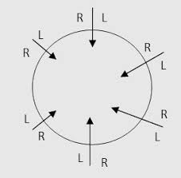
circular SEATING ARRANGEMENTs
Facing inward:
Left is clockwise.
Right is anti-clockwise.

Slide 38
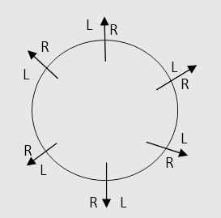
circular SEATING ARRANGEMENTs
Facing outward:
Right is clockwise.
Left is anti-clockwise.

Slide 39
circular SEATING ARRANGEMENTs
23.Six friends are sitting in a circle and are facing the centre of the circle. Deepa is between Prakash and Pankaj. Priti is between Mukesh and Lalit. Prakash and Mukesh are opposite to each other. Lalit Right of Prakash.
Who is sitting Second right to Lalit? [Infosys]
a. Mukesh b. Deepa c. Pankaj d. Lalit

Slide 40
circular SEATING ARRANGEMENTs
24.P, Q, R, S and T are sitting around a circular table. R is to the right of P and is second to the left of S. T is not between P and S. [Accenture]
Who is second to the left of R?
(a) Q (b) S (c) T (d)P

Slide 41
circular SEATING ARRANGEMENTs
25.Six persons A, B, C, D, E and F are standing in a circle. B is between D and C. A between E and C. F is to the right of D.
Who is between A and F?
(a) C (b) D (c) F (d)E

Slide 42
circular SEATING ARRANGEMENTs
26.P, Q, R, S, T, U, V and W are sitting round the circle and are facing the centre: P is second to the right of T, who is the neighbour of R and V. S is not the neighbour of P. V is the neighbour of U. Q is not between S and W. W is not between U and S.
Which two of the following are not neighbours? [Accenture]
a. RV b. UV c. RP d. QW

Slide 43
circular SEATING ARRANGEMENTs
27.Five students A, B, C, D and E are sitting around a circular table facing away from the center. C is sitting second to the right of D and to the immediate left of E. C and D an immediate neighbors of A.
Which of the following statements is true? [TCS]
B is sitting to the immediate left of D
A is sitting third to the left of E
A and B are the immediate neighbors of D
B is sitting second to the right of A

Slide 44
POLYGONAL SEATING ARRANGEMENTs
polygonal SEATING ARRANGEMENTs

Slide 45
POLYGONAL SEATING ARRANGEMENTs
A,B, C, D, E, F, G and H are sitting around a rectangle table facing the center of the table (but not necessarily in the same order). Four of them are sitting at the corners while four of them are sitting at the exact center of the sides, A is on the immediate right of H who is sitting at the exact center of one of the sides of the table. D is an immediate neighbor of A. B is sitting on the immediate right of D. F is the immediate neighbor of B and C. E is sitting to the immediate left of G.
28.Who is sitting to the immediate left of H? [TCS]
a)G b)D c)E d)F

Slide 46
POLYGONAL SEATING ARRANGEMENTs
29.Six friends P, Q, R, S, T and U are sitting around the hexagonal table each at one corner and are facing the centre of the hexagonal. P is second to the left of U. Q is neighbour of R and S. T is second to the left of S.
Which one is sitting opposite to P ? [Accenture]
a. R b. Q c. T d. S

Slide 47
POLYGONAL SEATING ARRANGEMENTs
(Directions 30-34) Study the following information carefully and answer the questions given below.
Eight persons P, Q, R, S, T, U, V and W are sitting in a rectangular table and facing away from the centre such that two persons are sitting at each side of the rectangular table, but not necessarily in the same order.
S sits third to the left of U. Two persons sit between T and S. P sits second to the left of S. Two persons sit between Q and P. Two persons sit between W and V who does not sits with U. W sits second to the left of Q. P and T does not sits same side of the table.

Slide 48
POLYGONAL SEATING ARRANGEMENTs
(Directions 30-34) Study the following information carefully and answer the questions given below. [Infosys]
Eight persons P, Q, R, S, T, U, V and W are sitting in a rectangular table and facing away from the centre such that two persons are sitting at each side of the rectangular table, but not necessarily in the same order.
S sits third to the left of U. Two persons sit between T and S. P sits second to the left of S. Two persons sit between Q and P. Two persons sit between W and V who does not sits with U. W sits second to the left of Q. P and T does not sits same side of the table.
30.What is the position of T with respect to R?
a)Second left b)Third left
c)Second right d)Third right

Slide 49
POLYGONAL SEATING ARRANGEMENTs
(Directions 30-34) Study the following information carefully and answer the questions given below. [Infosys]
Eight persons P, Q, R, S, T, U, V and W are sitting in a rectangular table and facing away from the centre such that two persons are sitting at each side of the rectangular table, but not necessarily in the same order.
S sits third to the left of U. Two persons sit between T and S. P sits second to the left of S. Two persons sit between Q and P. Two persons sit between W and V who does not sits with U. W sits second to the left of Q. P and T does not sits same side of the table.
31.How many persons sit between Q and P when counted right side of Q?
a)Two b)Five c)One d)Four

Slide 50
POLYGONAL SEATING ARRANGEMENTs
(Directions 30-34) Study the following information carefully and answer the questions given below.
Eight persons P, Q, R, S, T, U, V and W are sitting in a rectangular table and facing away from the centre such that two persons are sitting at each side of the rectangular table, but not necessarily in the same order.
S sits third to the left of U. Two persons sit between T and S. P sits second to the left of S. Two persons sit between Q and P. Two persons sit between W and V who does not sits with U. W sits second to the left of Q. P and T does not sits same side of the table.
32.Who sits on the same side on which T sits?
a) V b) Q c) W d) S

Slide 51
POLYGONAL SEATING ARRANGEMENTs
(Directions 30-34) Study the following information carefully and answer the questions given below.
Eight persons P, Q, R, S, T, U, V and W are sitting in a rectangular table and facing away from the centre such that two persons are sitting at each side of the rectangular table, but not necessarily in the same order.
S sits third to the left of U. Two persons sit between T and S. P sits second to the left of S. Two persons sit between Q and P. Two persons sit between W and V who does not sits with U. W sits second to the left of Q. P and T does not sits same side of the table.
33.Four of the following five are related to each other in some way and thus formed a group. Choose the one which does not belong to that group?
a) R b) P c) T d) W e) U

Slide 52
POLYGONAL SEATING ARRANGEMENTs
(Directions 30-34) Study the following information carefully and answer the questions given below.
Eight persons P, Q, R, S, T, U, V and W are sitting in a rectangular table and facing away from the centre such that two persons are sitting at each side of the rectangular table, but not necessarily in the same order.
S sits third to the left of U. Two persons sit between T and S. P sits second to the left of S. Two persons sit between Q and P. Two persons sit between W and V who does not sits with U. W sits second to the left of Q. P and T does not sits same side of the table.
34.Who sits 2nd to the left of R?
a) P b) S c) V d) T e) W

Slide 53
POLYGONAL SEATING ARRANGEMENTs
(Directions 35-38) Study the following information carefully and answer the questions given below. [TCS]
8 persons E, F, G, H, I, J, K and L are seated around a square table - two on each side. There are 3 ladies who are not seated next to each other. J is between L and F. G is between I and F. H, a lady member is second to the left of J. F, a male member is seated opposite to E, a lady member. There is a lady member between F and I.
35.Who among the following is to the immediate left of F?
a. G b. I c. J d. H

Slide 54
POLYGONAL SEATING ARRANGEMENTs
(Directions 35-38) Study the following information carefully and answer the questions given below.
8 persons E, F, G, H, I, J, K and L are seated around a square table - two on each side. There are 3 ladies who are not seated next to each other. J is between L and F. G is between I and F. H, a lady member is second to the left of J. F, a male member is seated opposite to E, a lady member. There is a lady member between F and I.
36.Which of the following statement is true?
a. J is male, K is female b. J is female, K is male
c. J & K are Both are female d. J & K are Both are male

Slide 55
POLYGONAL SEATING ARRANGEMENTs
(Directions 35-38) Study the following information carefully and answer the questions given below.
8 persons E, F, G, H, I, J, K and L are seated around a square table - two on each side. There are 3 ladies who are not seated next to each other. J is between L and F. G is between I and F. H, a lady member is second to the left of J. F, a male member is seated opposite to E, a lady member. There is a lady member between F and I.
37.How many persons are seated between K and F?
a. 1 b. 2 c. 3 d. 4

Slide 56
POLYGONAL SEATING ARRANGEMENTs
(Directions 35-38) Study the following information carefully and answer the questions given below.
8 persons E, F, G, H, I, J, K and L are seated around a square table - two on each side. There are 3 ladies who are not seated next to each other. J is between L and F. G is between I and F. H, a lady member is second to the left of J. F, a male member is seated opposite to E, a lady member. There is a lady member between F and I.
38.Who among the following are three lady members?
a. E, H and J b. E, F and G
c. E, H and G d. C, H and J

Slide 57
ARRANGEMENTs
Direction: (39-40) Study the following information carefully to answer the given questions. Seven boxes P, Q, R, S, T, U and V are kept one above the other like a stack, but not necessarily in the same order. The bottommost box is numbered 1 and topmost box is numbered 7
Only two boxes between Q and U. Only three boxes between T and V, which is below T. Box V is not the bottom most position. Box R is above box S. Number of boxes between V and U is same as between T and P. The number of boxes above and below U is same.
39.How many boxes between R and Q? [Accenture]
a) Two b) Four c) Three d) One e) More than four

Slide 58
ARRANGEMENTs
Direction: (39-40) Study the following information carefully to answer the given questions. Seven boxes P, Q, R, S, T, U and V are kept one above the other like a stack, but not necessarily in the same order. The bottommost box is numbered 1 and topmost box is numbered 7
Only two boxes between Q and U. Only three boxes between T and V, which is below T. Box V is not the bottom most position. Box R is above box S. Number of boxes between V and U is same as between T and P. The number of boxes above and below U is same.
40.How many boxes below box V? [Accenture]
a) Two b) Four c) Three d) One e) More than four

Slide 59
PUZZLES
Study the following information carefully and answer the below questions.
Nine persons – B, F, H, K, O, S, U, W, and Z are sitting around a circular table in such a way that some of them are facing the center whereas other sits facing away from the center. Not more than two persons sitting together are facing in the same direction.
O sits third to the right of F, both are facing in the same direction. Neither O nor F sits adjacent to K. The person sitting immediate right of K sits fourth to the right of U. U doesn’t sit adjacent to O but sits facing center. K and S, who doesn’t sit adjacent to F, are sitting second to the right of each other. Z sits third to the right of B. Neither S nor F sits adjacent to B. The persons sitting adjacent to B are facing in opposite direction. H and W are sitting second to the left of each other. W and K are not sitting together. Z and O are facing the same direction.

Slide 60
PUZZLES

Slide 61
PUZZLES

Slide 62
PUZZLES

Slide 63

This Photo by Unknown Author is licensed under CC BY-SA

